Slide 1
THE PANCREAS
Dr. arun r nair
Dept. of Practice of medicine

Slide 2
ANATOMY
The pancreas is a solid organ that lies transversely in the retroperitoneum deep within the epigastrium.
It is firmly fixed by fibrous attachments anterior to the suprarenal aorta and the first and second lumbar vertebrae.
Thus, the pain of acute or chronic pancreatitis is situated deep in the epigastric region and frequently radiates to the back.
The pancreas is about 15 cm long, although the normal pancreas weighs less than 110 g.

Slide 3
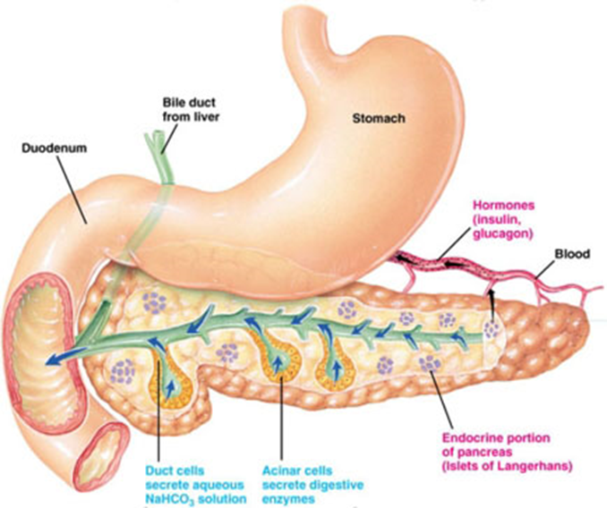
Pancreas can be divided into four parts: head, including the
uncinate process; neck; body; and tail.
The head is the thickest part of the gland (2–4 cm) and lies in the “c-loop” or curved space between the first, second, and third portions
of the duodenum.

Slide 4
STRUCTURE AND FUNCTION
Structure
The pancreas extends retro-peritoneally across the posterior abdominal wall from the second part of the duodenum to the spleen.
The head is encircled by the duodenum; the body, which forms the main bulk of the organ, ends in a tail that lies in contact with the spleen.
The pancreas consists of exocrine and endocrine cells, the exocrine making up 98% of the human pancreas.

Slide 5
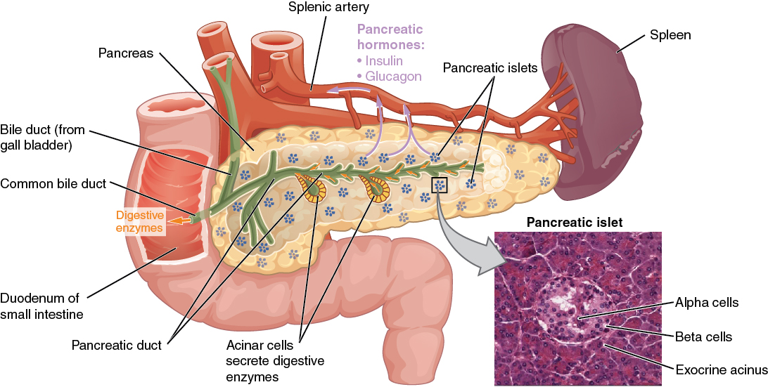

Slide 6
Exocrine function
The pancreatic acinar cells are responsible for production of digestive enzymes.
These include amylase, lipase, colipase, phospholipase and the proteases (trypsinogen and chymotrypsinogen).
These enzymes are stored within the acinar cells in secretory granules and are released by exocytosis

Slide 7
The endocrine pancreas
This consists of hormone-producing cells arranged in nests or islets (islets of Langerhans).
The hormones produced are secreted directly into the circulation and there is no access to the pancreatic ductular system.
There are many types of islet cell corresponding to different secretory components.
The beta cells are the most common and are responsible for insulin and Amylin production(70%).
The Alpha cells produce glucagon (<20%).
The Delta cells produce somatostatin (<10%), PP cells produce pancreatic polypeptide (<5%).

Slide 8
PANCREATITIS

Slide 9
Classification
Pancreatitis is divided into acute and chronic. By definition acute pancreatitis is a process that occurs on the background of a previously normal pancreas and can return to normal after resolution of the episode. In chronic pancreatitis there is continuing inflammation with irreversible structural changes.

Slide 10
Acute pancreatitis
Acute pancreatitis is a syndrome of inflammation of the pancreatic gland initiated by an acute injury.
In the western world, gallstones and alcohol account for the vast majority of episodes. Alcohol also causes chronic pancreatitis.
The severity of the pancreatitis may range from mild and self-limiting to extremely severe, with extensive pancreatic and peripancreatic necrosis as well as haemorrhage.
In the most severe form (approximately 10% of cases), the mortality is between 40% and 50%.

Slide 11
Causes of pancreatitis
Common Causes
Gallstones (including microlithiasis) (30–60%).
Alcohol (acute and chronic alcoholism) 15–30%
Hypertriglyceridemia 1.3–3.8%
Endoscopic retrograde cholangiopancreatography (ERCP), especially after biliary manometry 5–10%
Drugs (azathioprine, 6-mercaptopurine, sulfonamides, estrogens, tetracycline,
valproic acid, anti-HIV medications, 5-aminosalicylic acid [5-ASA])
Trauma (especially blunt abdominal trauma)
Postoperative (abdominal and non abdominal operations)

Slide 12
Causes of pancreatitis (Con’t)
Uncommon Causes
Vascular causes and vasculitis (ischemic-hypoperfusion states after cardiac surgery)
Connective tissue disorders and thrombotic thrombocytopenic purpura (TTP)
Cancer of the pancreas
Hypercalcemia
Periampullary diverticulum
Pancreas divisum
Hereditary pancreatitis
Cystic fibrosis
Renal failure
Infections (mumps, coxsackievirus, cytomegalovirus, echovirus, parasites)
Autoimmune (e.g., type 1 and type 2)

Slide 13
THE PATHOGENESIS OF ACUTE PANCREATITIS
Pancreatitis is a disease that evolves in three phases.
The initial phase is characterized by intra-pancreatic digestive enzyme activation and acinar cell injury.
Trypsin activation appears to be mediated by lysosomal hydrolases
such as cathepsin B that become colocalized with digestive enzymes in intracellular organelles; it is currently believed that acinar cell injury is the consequence of trypsin activation.

Slide 14
The second phase of pancreatitis involves the activation, chemoattraction (unidirectional movement of cells to the activation), and sequestration of leukocytes and macrophages in the pancreas, resulting in an enhanced intrapancreatic inflammatory reaction. Neutrophil depletion induced by prior administration of an antineutrophil serum has been shown to reduce the severity of experimentally induced pancreatitis. There is also evidence to support the concept that neutrophils can activate trypsinogen. Thus, intrapancreatic acinar cell activation of trypsinogen could be a two-step process

Slide 15
The third phase of pancreatitis
is due to the effects of activated proteolytic enzymes and cytokines,
released by the inflamed pancreas, on distant organs. Activated proteolytic enzymes, especially trypsin, not only digest pancreatic and peripancreatic tissues but also activate other enzymes such as elastase and phospholipase A2.
The active enzymes and cytokines then digest cellular membranes and cause proteolysis, edema, interstitial hemorrhage, vascular damage, coagulation necrosis, fat necrosis, and parenchymal cell necrosis.

Slide 16
Cellular injury and death result in the liberation of bradykinin peptides, vasoactive substances, and histamine that can produce vasodilation, increased vascular permeability, and edema with profound effects on many organs. The systemic inflammatory response syndrome (SIRS) and acute respiratory distress syndrome (ARDS), as well as multiorgan failure, may occur as a result of this cascade of local and distant effects.

Slide 17
Pathologically, acute pancreatitis varies from interstitial pancreatitis
(pancreas blood supply maintained), which is generally self-limited to
necrotizing pancreatitis (pancreas blood supply interrupted), in which
the extent of necrosis may correlate with the severity of the attack
and its systemic complications. Autodigestion is a currently accepted
pathogenic theory; according to this theory, pancreatitis results when
proteolytic enzymes (e.g., trypsinogen, chymotrypsinogen, proelastase,
and lipolytic enzymes such as phospholipase A2) are activated in the
pancreas acinar cell rather than in the intestinal lumen.

Slide 18
A number of factors (e.g., endotoxins, exotoxins, viral infections, ischemia, oxidative stress, lysosomal calcium, and direct trauma) are believed to facilitate premature activation of trypsin. Activated proteolytic enzymes, especially trypsin, not only digest pancreatic and peripancreatic tissues but also can activate other enzymes, such as elastase and phospholipase A2. Spontaneous activation of trypsin also can occur.

